Slide 1
STREAMING INTRO
Marcel Däppen

Slide 2
INTRO

Slide 3

APACHE FLINK IN A NUTSHELL
CSV
ORC, Elastic, CSV, …
Apache Flink
Producer
Apache Kafka
Consumer
Topic:
Producer
Topic:
Consumer

Slide 4
PROGRAMMING MODEL

Slide 5
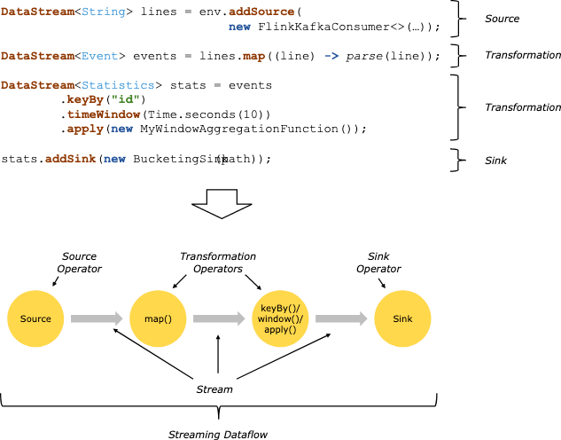
DATAFLOW PROGRAMMING MODEL

Slide 6
DATAFLOW PROGRAMMING MODEL

Slide 7
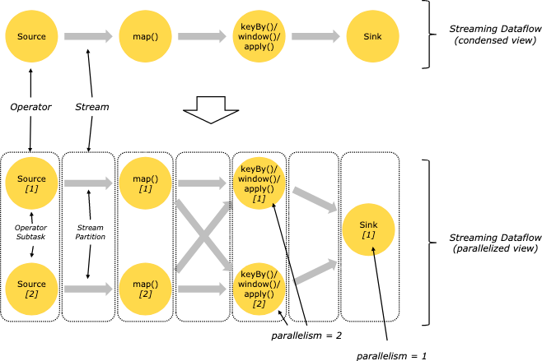
PARALLEL DATAFLOWS
At least one thread for each Kafka partition

Slide 8
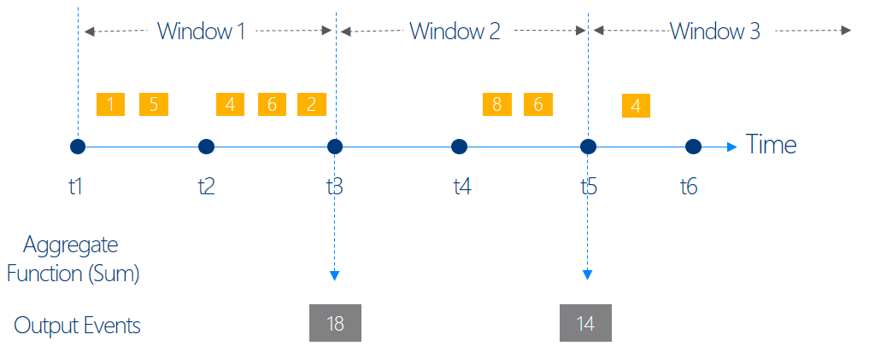
WINDOWS

Slide 9
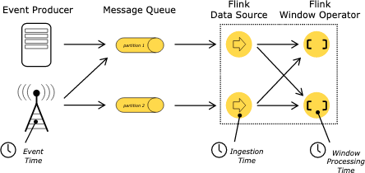
TIME

Slide 10
FSI USE CASE

Slide 11
FSI USE CASE OVERVIEW (subset)
Flink App
Flink App
Flink App
Flink App
UC 1
COUNT
trx_per_shop
UC 2
SUM
trx_typ_fx
UC 3
JOIN
trx_fx_Combined
UC 4
TABLE
fx_RiskCalc
Topic: result_uc1_trx_per_shop
Kafka
Topic: result_uc2_trx_typ_fx
Topic: result_uc3_TrxFxCombined
Topic: result_uc4_fx_RiskCalc
FX rates: KafkaJsonProducer_fx
Topic: fx
CC transactions:
KafkaJsonProducer_trx
Topic: trx

Slide 12
FSI USE CASE 1:
Flink App
UC 1
COUNT
trx_per_shop
Topic: result_uc1_trx_per_shop
Kafka
CC transactions:
KafkaJsonProducer_trx
Topic: trx

Slide 13


FSI USE CASE 1:
Counter:
"ABC” | 23
CC transactions:
KafkaJsonProducer_trx
Counter:
”BioMarket” | 61
{
"timestamp":1566829043004,
"cc_id":"5123-5985-1943-6358",
"cc_type":"Maestro",
"shop_id":3,
"shop_name":"SihlCity",
"fx":"USD",
"fx_account":"CHF",
"amount_orig":40.0
}
Tuple 2:
shop_name |Counter
"SihlCity” |1
Counter:
”SihlCity” | 19
FlatMap
keyBy:
Shop_name

Slide 14
FSI USE CASE 2:
Flink App
UC 2
SUM
trx_typ_fx
Kafka
Topic: result_uc2_trx_typ_fx
CC transactions:
KafkaJsonProducer_trx
Topic: trx

Slide 15


FSI USE CASE 2:
Sum:
”Revolut” | CHF | EURO | 3’152.210
CC transactions:
KafkaJsonProducer_trx
Sum:
”Maestro” | USD | EUR | 852.75
{
"timestamp":1566829043004,
"cc_id":"5123-5985-1943-6358",
"cc_type":"Maestro",
"shop_id":3,
"shop_name":"SihlCity",
"fx":"USD",
"fx_account":"CHF",
"amount_orig":40.0
}
Tuple 4:
Cc_type |fx |fx_account | amount_orig
Maestro |USD |CHF |40.0
Sum:
”Maestro” | USD | CHF | 1’652.27
FlatMap
keyBy:
Cc_Type | fx

Slide 16
FSI USE CASE 3:
Flink App
UC 3
JOIN
trx_fx_Combined
Kafka
Topic: result_uc3_TrxFxCombined
FX rates: KafkaJsonProducer_fx
Topic: fx
CC transactions:
KafkaJsonProducer_trx
Topic: trx

Slide 17




FSI USE CASE 3:
FX rates: KafkaJsonProducer_fx
{
"fx_target":”CHF",
"fx":”USD",
"fx_rate":1.12,
"timestamp": 1566829043001
}
Join
{
"fx":{
"fx_target":"CHF",
"fx":"USD",
"fx_rate":1.12,
"timestamp":1566829043001
},
"trx":{
"timestamp":1566829043004,
"cc_id":"5123-5985-1943-6358",
"cc_type":"Maestro",
"shop_id":3,
"shop_name":"SihlCity",
"fx":"USD",
"fx_account":"CHF",
"amount_orig":40.0
}
}
Publishing to Kafka
CC transactions:
KafkaJsonProducer_trx
{
"timestamp":1566829043004,
"cc_id":"5123-5985-1943-6358",
"cc_type":"Maestro",
"shop_id":3,
"shop_name":"SihlCity",
"fx":"USD",
"fx_account":"CHF",
"amount_orig":40.0
}
Tuple :
fx & fx_account
USD_CHF
FlatMap

Slide 18
FSI USE CASE 5:
Flink App
UC 5
COUNT
trx_duplicated_check
Topic: result_uc5_trx_duplicated_check
Kafka
CC transactions:
KafkaJsonProducer_trx
Topic: trx

Slide 19




FSI USE CASE 5:
filter out if the fingerprint is unique within the window {30 sec}
Counter:
" 5127-3281-3201-7361_EUR_USD_17.81” | 1
CC transactions:
KafkaJsonProducer_trx
Counter:
"5167-5669-5336-6937_CHF_EUR_72.49” | 1
{
"timestamp":1566829043004,
"cc_id":"5123-5985-1943-6358",
"cc_type":"Maestro",
"shop_id":3,
"shop_name":"SihlCity",
"fx":"USD",
"fx_account":"CHF",
"amount_orig":40.0
}
Tuple 2:
Trx_fingerprint (cc_id + fx + fx_account + amount_orig) |Counter
"5123-5985-1943-6358_USD_CHF_40.0” |1
Counter:
” 5123-5985-1943-6358_USD_CHF_40.0” | 3
FlatMap
keyBy:
Shop_name

Slide 20
FSI USE CASE 6:
TumblingProcessingTimeWindows
per Credit Card ID
Flink App
UC 6
Filter
ccTrxFraud
amount
Topic: result_uc6_ccTrxFraud
Kafka
40
t0
time
60 sec.
60 sec.
CC transactions:
KafkaJsonProducer_trx
Topic: trx

Slide 21
FSI USE CASE 6:
filter out if the cc-id is unique within the window {30 sec} && amount <40.00
Counter:
" 5127-3281-3201-7361” | “7.81” | 7
CC transactions:
KafkaJsonProducer_trx
Counter:
"5167-5669-5336-6937” | “72.49” | 1
{
"timestamp":1566829043004,
"cc_id":"5123-5985-1943-6358",
"cc_type":"Maestro",
"shop_id":3,
"shop_name":"SihlCity",
"fx":"USD",
"fx_account":"CHF",
"amount_orig":40.0
}
Tuple 2:
cc_id |Counter
" 5123-5985-1943-6358” |1
Counter:
” 5123-5985-1943-6358” | 40.0” | 3
FlatMap
keyBy:
Shop_name
Filter:
Amount > 40.00

Slide 22
FSI USE CASE

Slide 23
IoT USE CASE OVERVIEW (subset)
Flink App
Flink App
Flink App
UC 1
COUNT
trx_per_sensorId
UC 2
Filter
sensor_1 > 50
UC 3
Split
dispatcher2Topics
Topic: result_iot_Consumer_Count
Kafka
Topic: result_iot_Consumer_Filter
Topic: result_... _VendorA
Topic: result_... _VendorB
Topic: result_... _VendorX
IoT Sensor Simulator
KafkaIOTSensorSimulator
Topic: iot

